Slide 1
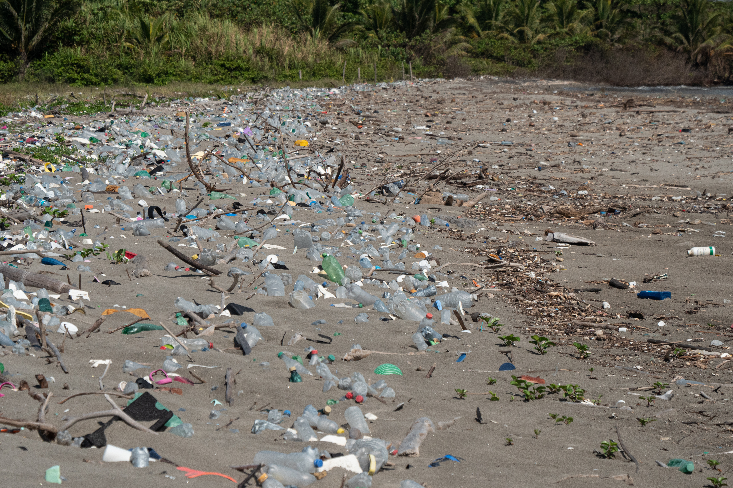
Increase in
Water Pollution
From a Medical Perspective
CANDIDATE #0100
FEBRUARY 23, 2022

Slide 2
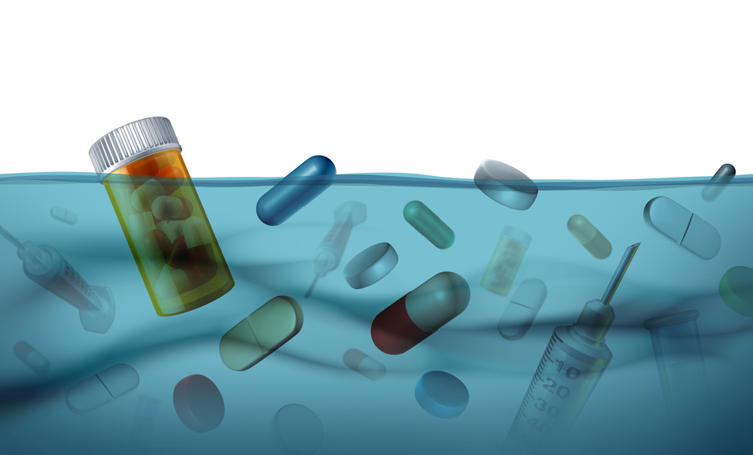
Drug Pollution
Modern medicines are polluting water
Locally
Bone fish population is declining is South Florida
Wastewater treatment centers are inefficient
Globally
Clean water from rivers aren’t available to use
Spreading disease, creates health problems

Slide 3
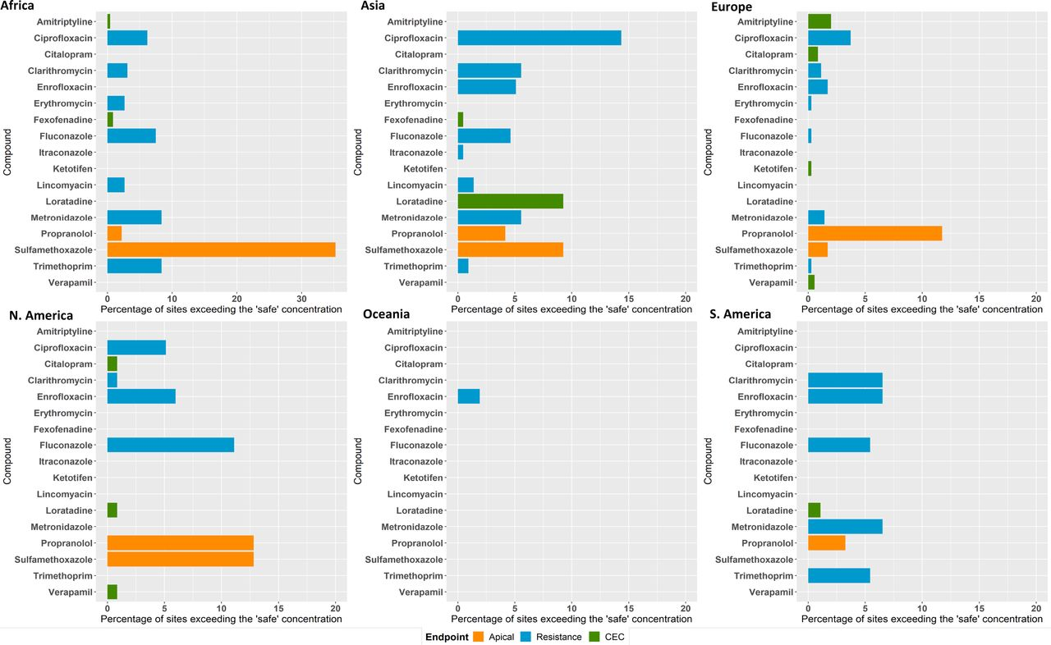
Percent Of Sites Where Concentrations Exceeded

Slide 4
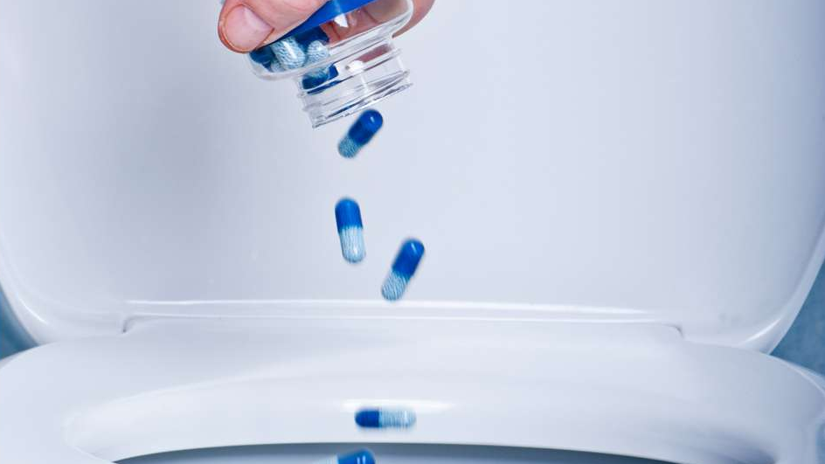
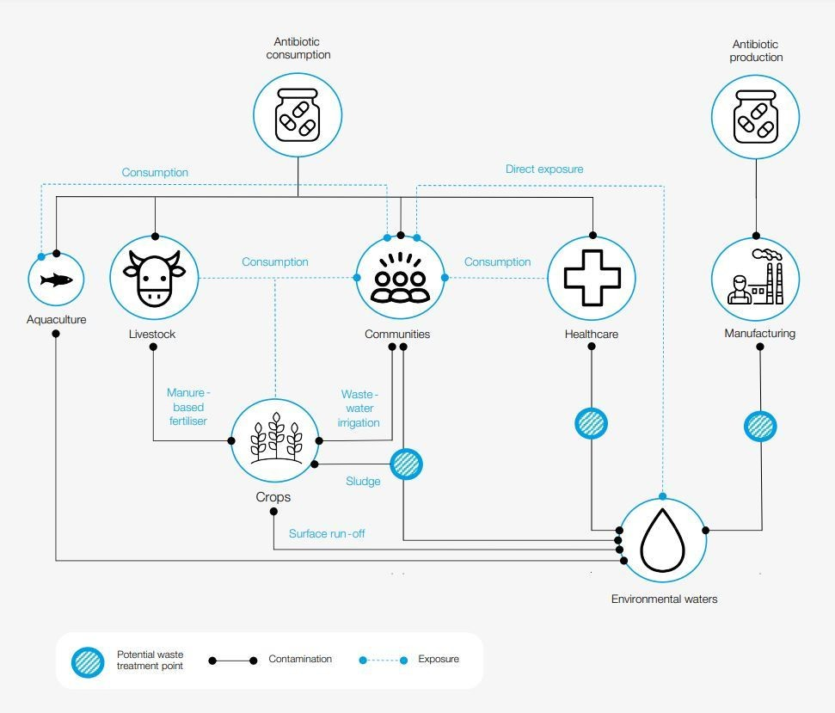
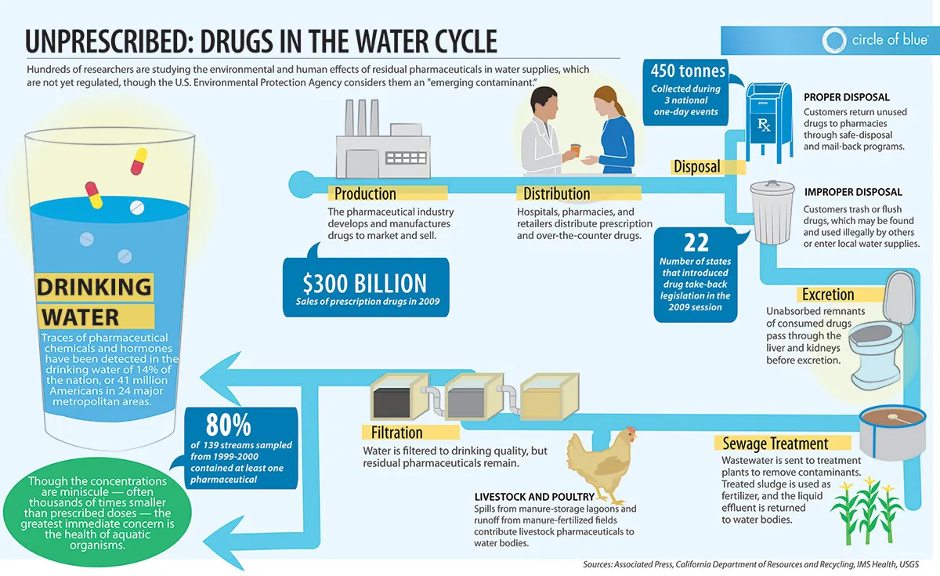
What Causes This?
Before discussing solutions,
we should know what causes this
Improper disposal of medicines
Undigested medicine in urine
Agricultural runoff from animals
This should be
analyzed and evaluated

Slide 5
Drugs In The Water Cycle

Slide 6
Drugs In The Water Cycle

Slide 7
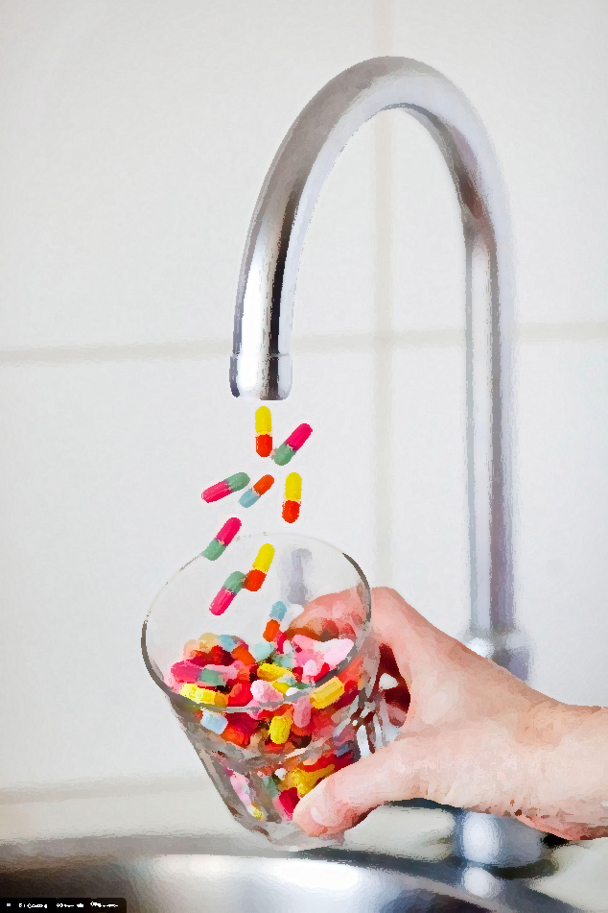
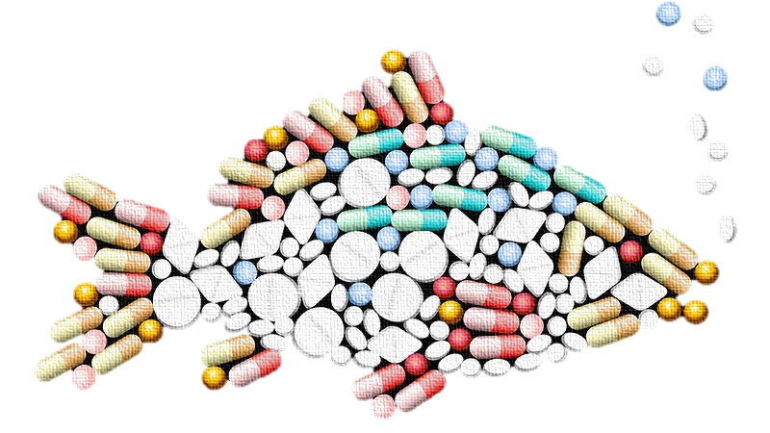
Why Should We Care?
Affects our main water supply
Affects our agriculture
Affects marine life and other organisms

Slide 8
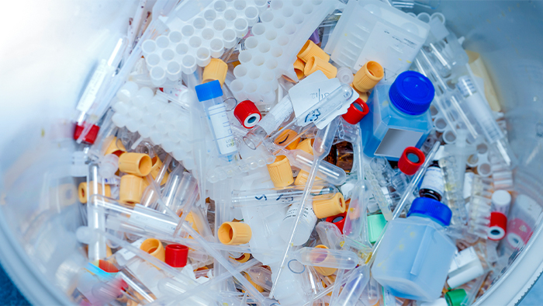
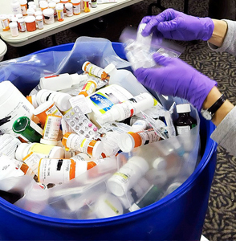
The Solution
Locally
Create better wastewater management
More rules and regulations
Globally
Create more infrastructure
Reducing drug waste

Slide 9
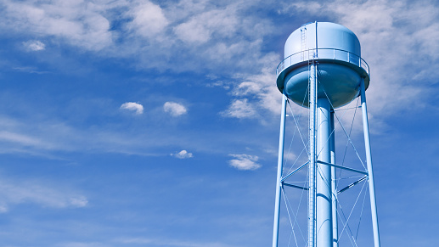
Why This Is Effective
Strengths
Weaknesses
Reduces the amount of pollution
Implements future preventatives
More diverse solution
More restrictions = Harder to access
Potentially expensive
Hard to implement

Slide 10
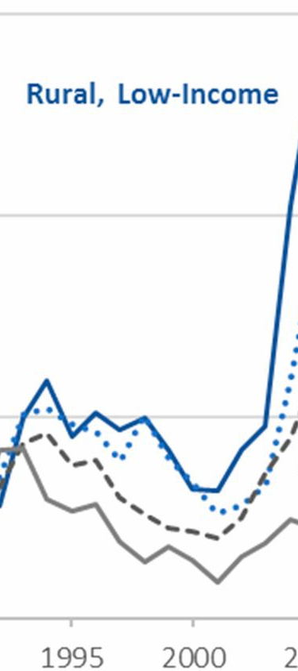
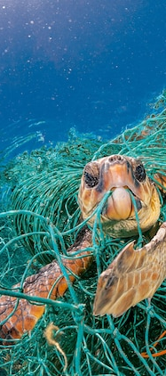
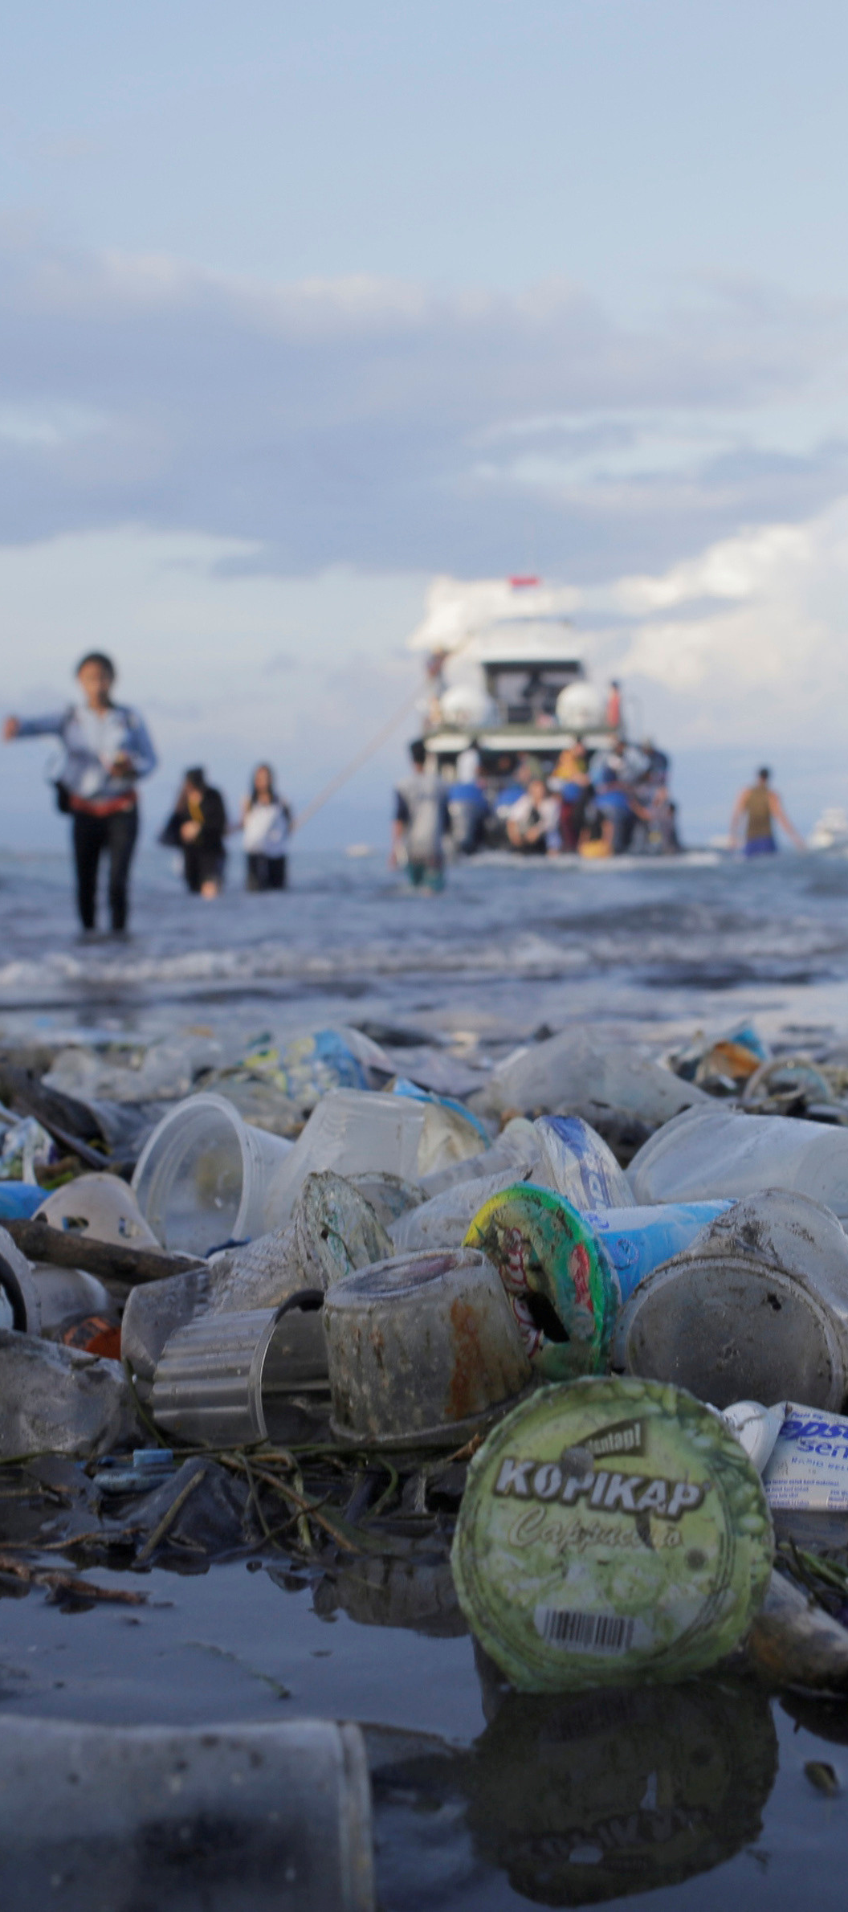
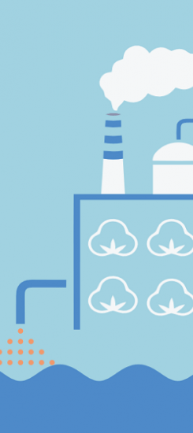
Perspectives
Economy
Wildlife
Tourism
Business
Why my solution is the best
A problem that won't go away
An increase in the problem
Effective and preventative method

Slide 11
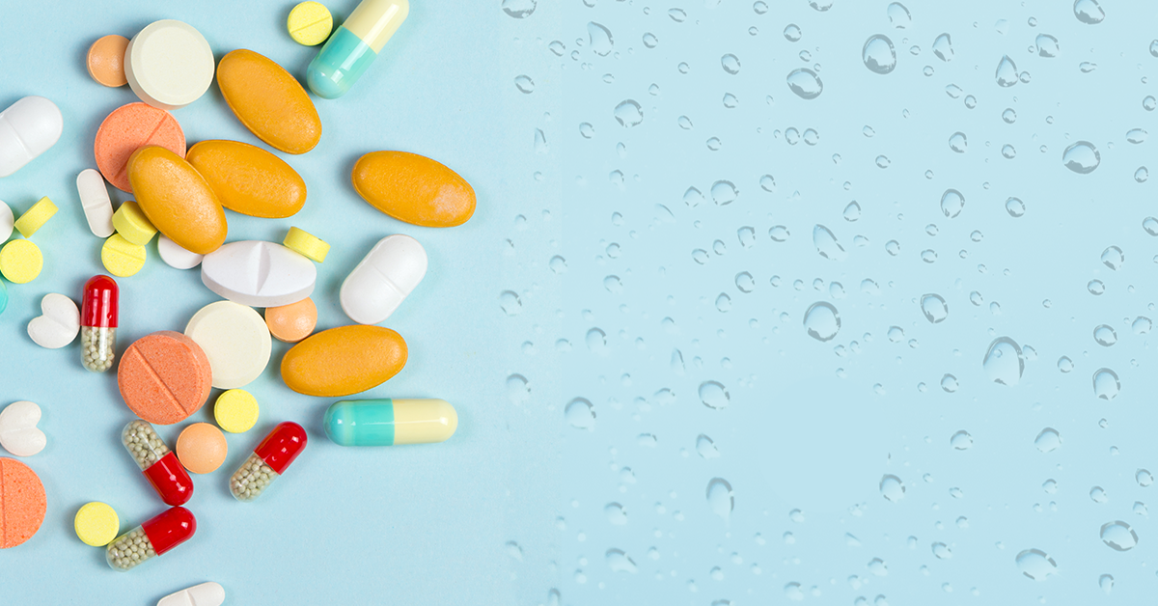
Conclusion
Things we need to do to
help the problem
Action Steps
Educate ourselves and others
Create policies
Regulate the industry

Slide 12
Sources
https://www.health.harvard.edu/newsletter_article/drugs-in-the-water
https://hakaimagazine.com/features/the-search-for-whats-harming-floridas-beloved-bonefish/
https://www.pnas.org/content/119/8/e2113947119
https://www.bbc.com/news/science-environment-60380298
https://www.weforum.org/agenda/2022/02/pharmaceutical-pollution-health-drugs-rivers/
https://www3.weforum.org/docs/WEF_Antimicrobial_Resistance_and_Water_2021.pdf
https://www.theguardian.com/environment/2022/feb/14/drugs-have-dangerously-polluted-the-worlds-rivers-scientists-warn
https://ensia.com/notable/pharmaceuticals-drugs-medications-antiobiotics-endocrine-water-pollution/
Images
https://theoceancleanup.com/media-gallery/plastic-pollution/#&gid=1&pid=4
https://www.nationalgeographic.com/magazine/article/plastic-planet-animals-wildlife-impact-waste-pollution
https://medium.com/environmental-issue-profile-database/texas-needs-to-clean-up-its-act-and-its-water-b508de5a0afe
https://www.plasticfree-world.com/the-business-case-for-tackling-water-pollution-in-apparel-value-chains/
https://www.weforum.org/agenda/2019/03/tourism-is-killing-our-oceans-heres-what-we-can-do-to-protect-them/

